Slide 1
Repline Strategy
February 2016

Slide 2
Outline
Introduction to Replines
Description of Model Variables
Identification of Repline Variables
Tracking
Forward Projection

Slide 3
Introduction to Replines
Repline Definition
Replines are groupings of loans which are representative of the actual loans underlying
Repline Goal
The goal for repline creation is the reduction in dimensionality. Ex) 1,000,000 loans can be reduced to 1,000 replines.
Ideal Repline Algorithm
The ideal repline algorithm optimizes 2 outputs:
reduction in dimensionality
matches underlying distribution of loans
Repline Construction
Determine which loan characteristics to “bucket” by
Determine granularity of buckets within each loan characteristic
Group loans into the combination of these buckets
Average the loan characteristics within each of these combined buckets

Slide 4
Description of Model Variables
Curtailment Module
WALA
Default Module
WALA, CLTV, FICO, DTI, Occupancy
Turnover Module
WALA, CLTV, Hpa2yr, LockIn, Seasonality
Refinance Module
WALA, CLTV, Credit Availability, Incentive, Media, Loan Size, Burnout
13 variables total
Static: FICO, DTI, Occupancy, [State, Loan Coupon]*
Loan Independent: Credit Availability, Media, Hpa2yr
* Not in model, but available at loan level

Slide 5
Identification of Repline Variables
Repline Buckets
Loan Coupon – 64 buckets (12.5 bp increments)
FICO – 6 buckets
Occupancy – 2 buckets
DTI – 4 buckets
LoanSize – 4 buckets
State – 11 buckets (10 states + US)
Total Possible Replines = ~135,000
Conclusion
135,000 replines are computationally tractable for tracking
Clever selection of variables captures a large part of underlying distribution
Reduces dimensionality by order of ~100

Slide 6
Tracking
Overview
Taking the entire set of loan level data we have ~500MM observations
Under the proposed repline schema we could reduce dimensionality to < 130,000 replines per period. ~5MM observations
This results in a computationally tractable tracking process. We can run tracking on the entire universe of loans (converted to replines) in ~1HR
Our process of controlling for model variables helps us to reduce dimensionality but also captures a majority of the underlying distribution
The tracking results can easily be stored in IQ and used within Symphony in the same way that the Pool level tracking results are used

Slide 7
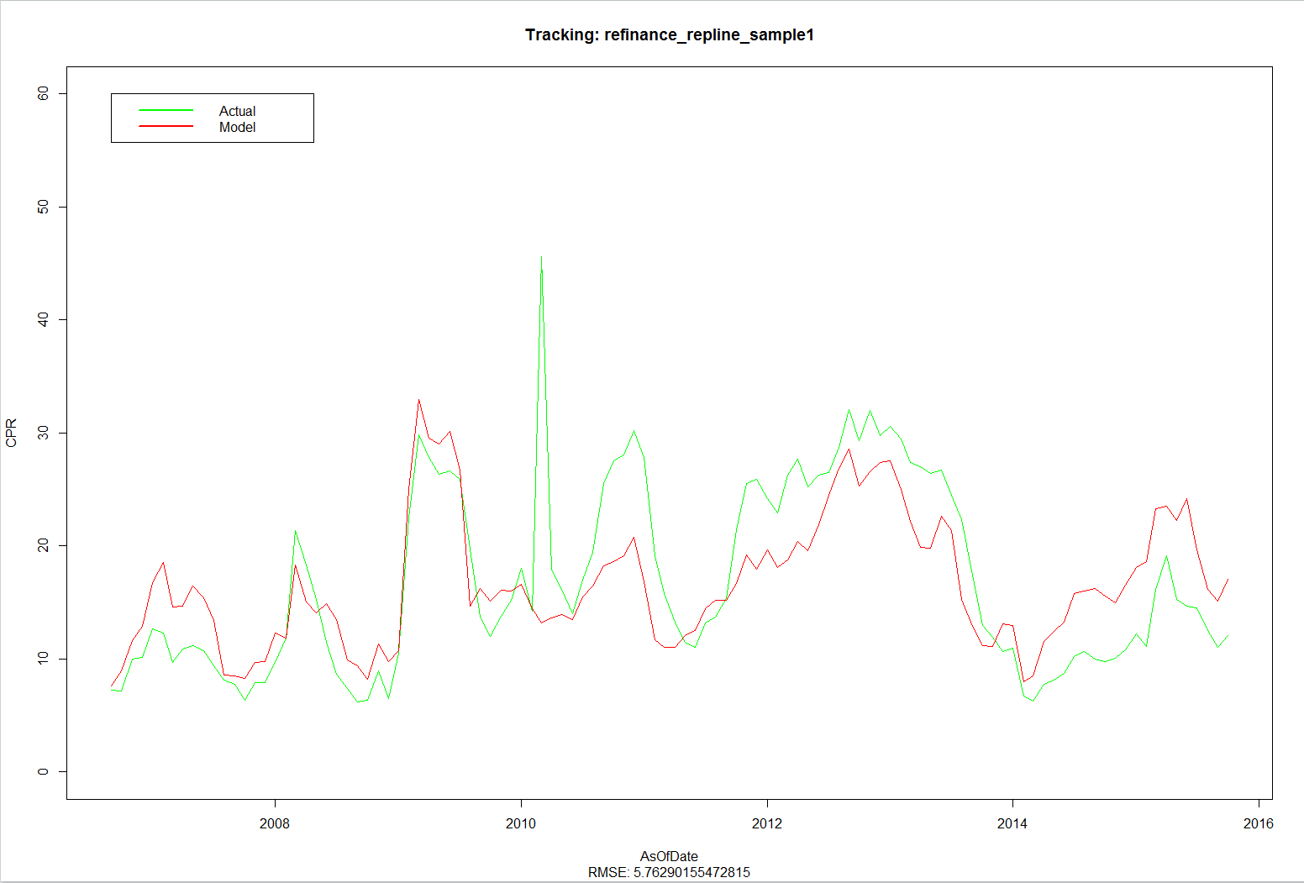
Tracking Results

Slide 8
Forward Projections
Overview
Taking the loan level data beneath a bond we could have 1,000+ loans
Scale has the ability to run projections very quickly (~100 / sec)
Hence a very granular repline algorithm can be used

Slide 9
OAS Projections
Overview
OAS is a much more time consuming calculation (~6 seconds / repline @ 200 paths)
Assuming the loan level data beneath a bond is 1,000+ loans
Under the proposed repline schema we could reduce dimensionality, but the reduction could be minimal with >100,000 possible repline combinations
To keep OAS calculations to ~1minute, we will need to have ~10 replines per bond
Reducing the dimensionality can easily be achieved by removing state from the repline algorithm
Removing state does not hurt our projections provided our HPA projections are at the US level
With state removed, we have ~12,000 possible replines which is a substantial reduction in dimension
The last step would be to map each loan into the top 9 repline buckets, with the remaining loans all mapped into 1 repline
This gives us a total of 10 replines, which should keep our OAS calculations manageable

